Slide 1
Chapter 8
Operating System Policies for VM
1

Slide 2
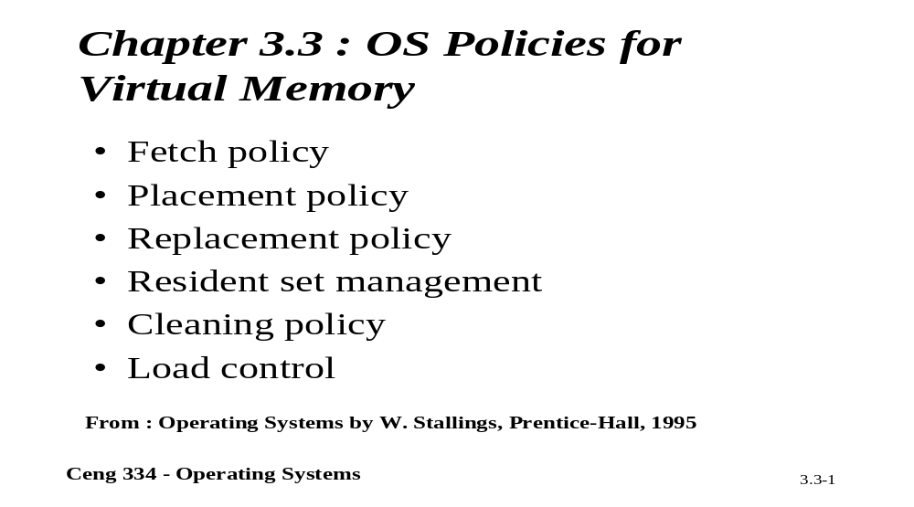
Chapter 3.3: Operating System Policies for VM

Slide 3
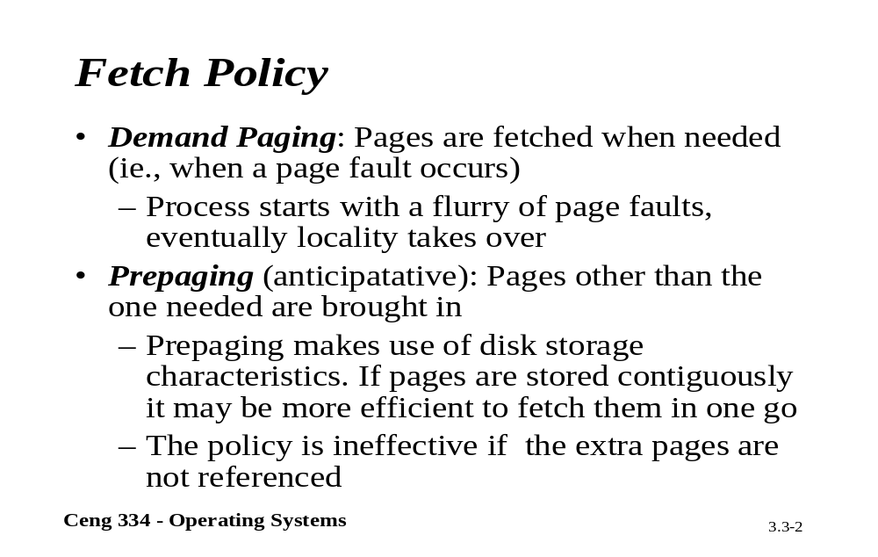
Fetch Policy

Slide 4
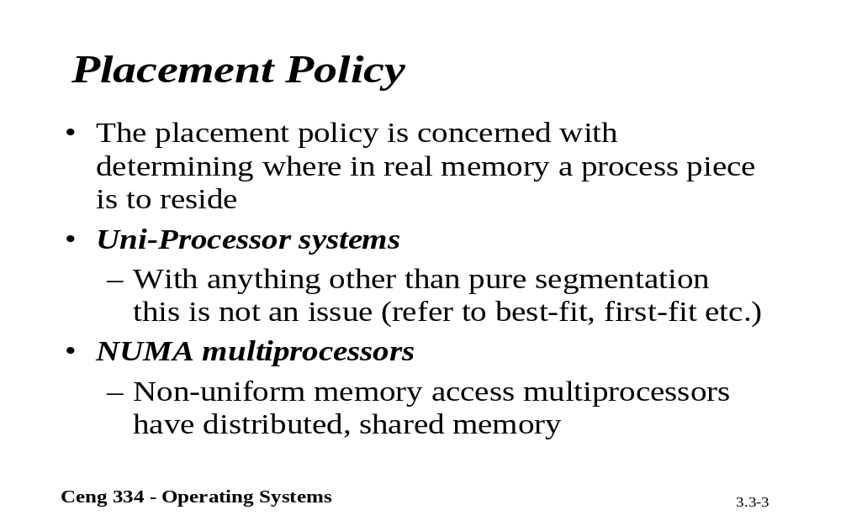
Placement Policy

Slide 5
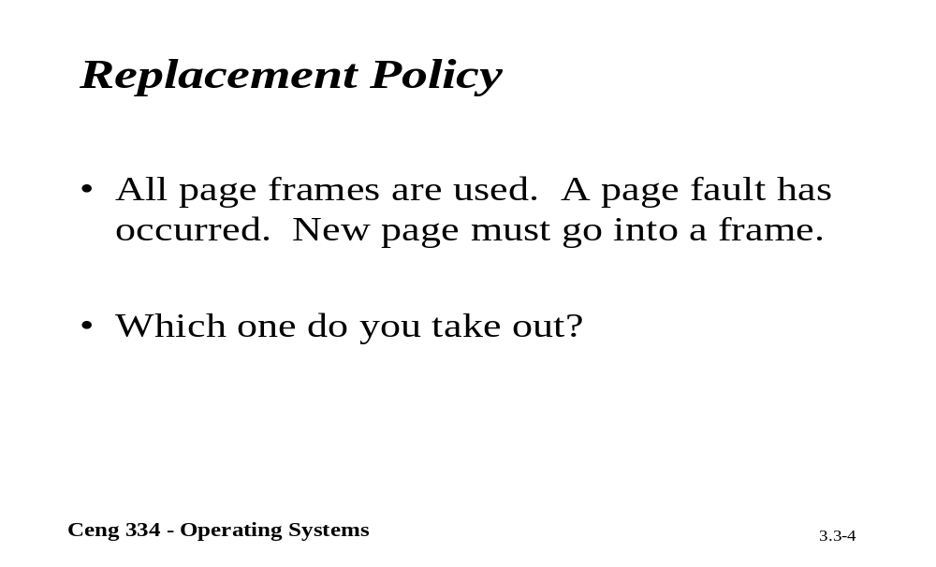
Replacements Policy

Slide 6
Page Replacement Algorithms
Page fault forces choice
  which page must be removed
  make room for incoming page
Modified page must first be saved
  unmodified just overwritten
Better not to choose an often used page
  will probably need to be brought back in soon

Slide 7
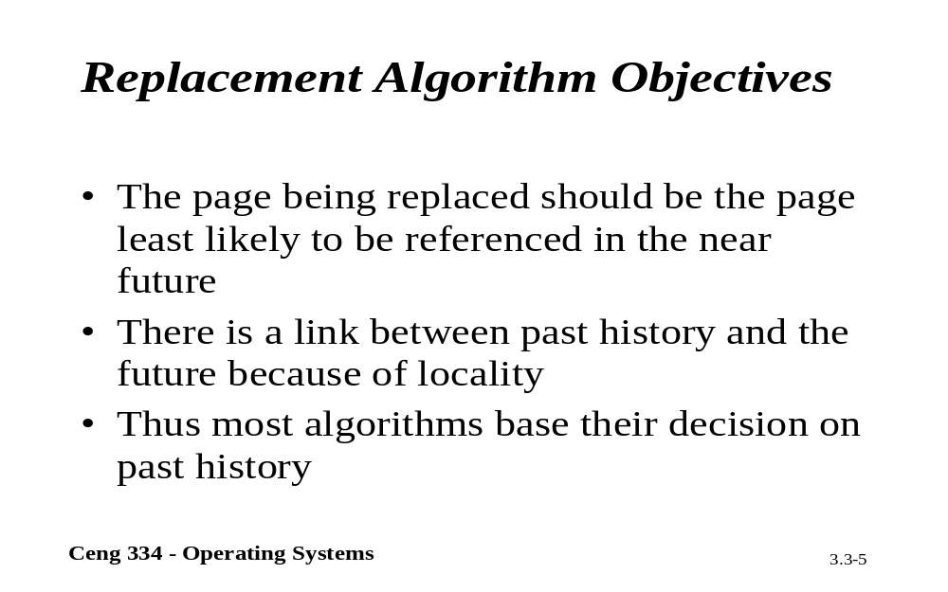
Replacements Algorithm Objectives

Slide 8
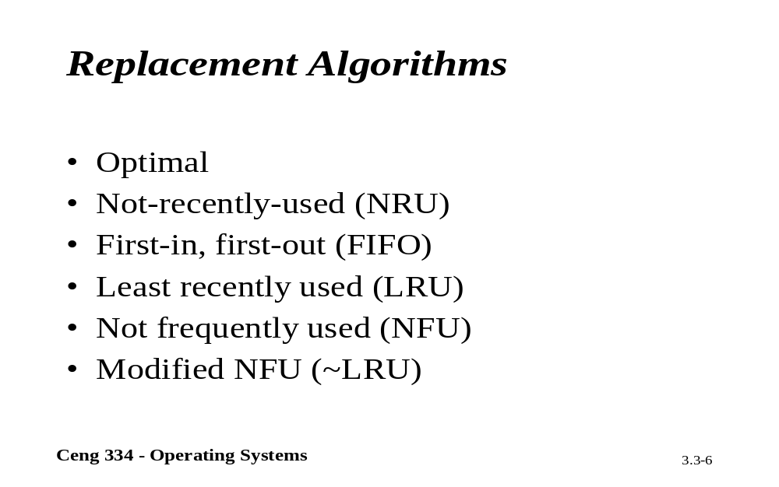
Placement Algorithms

Slide 9
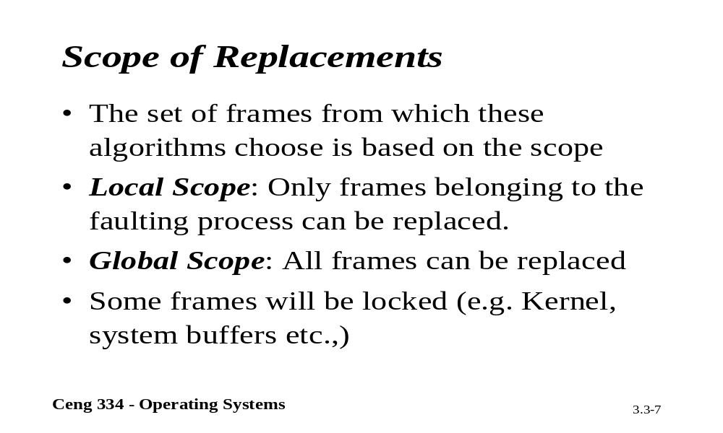
Scope of Replacements

Slide 10
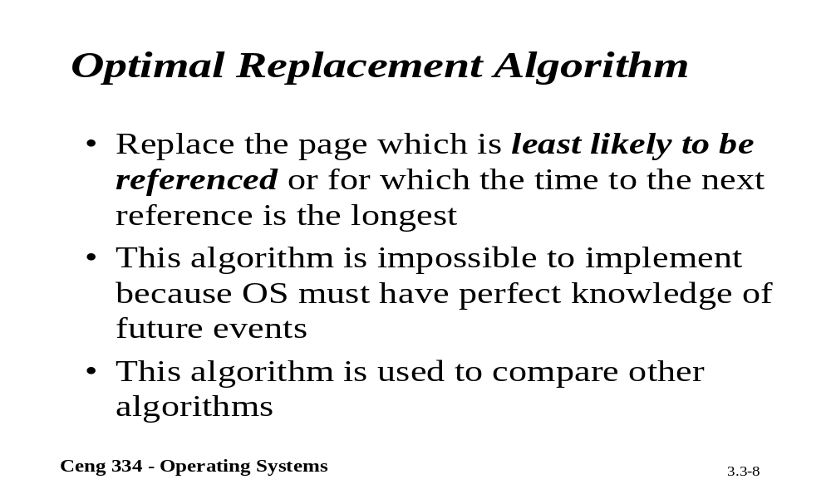
Optimal Replacement

Slide 11
Optimal Page Replacement Algorithm
Replace page needed at the farthest point in future
  Optimal but unrealizable
Estimate by …
  logging page use on previous runs of process
  although this is impractical

Slide 12
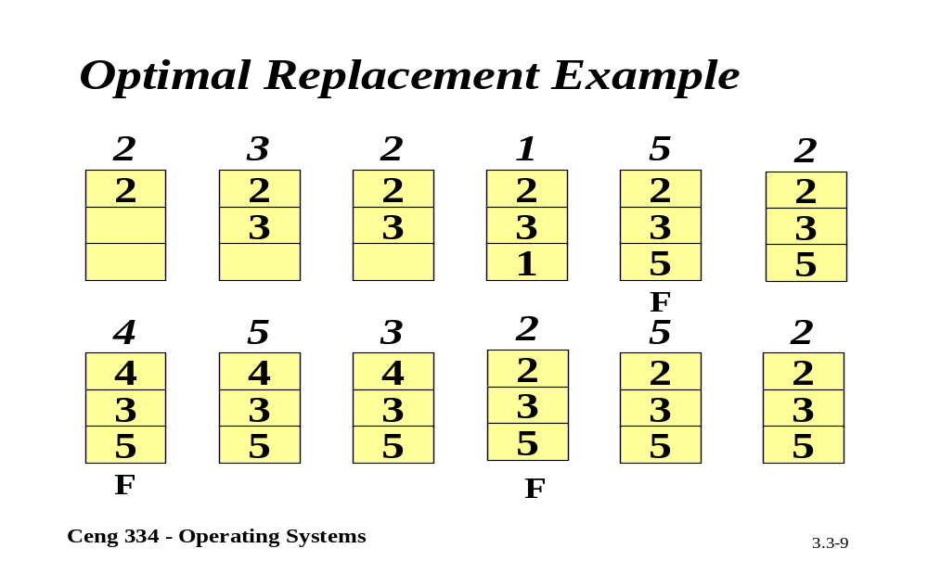
Optimal Replacement

Slide 13
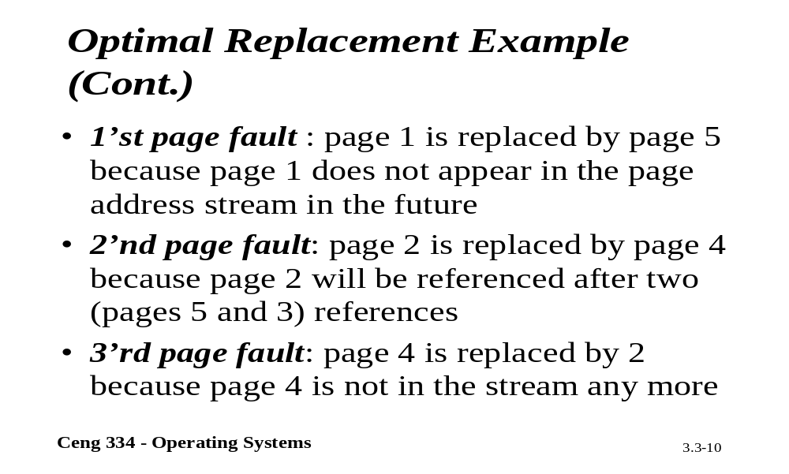
Optimal Replacement Example

Slide 14
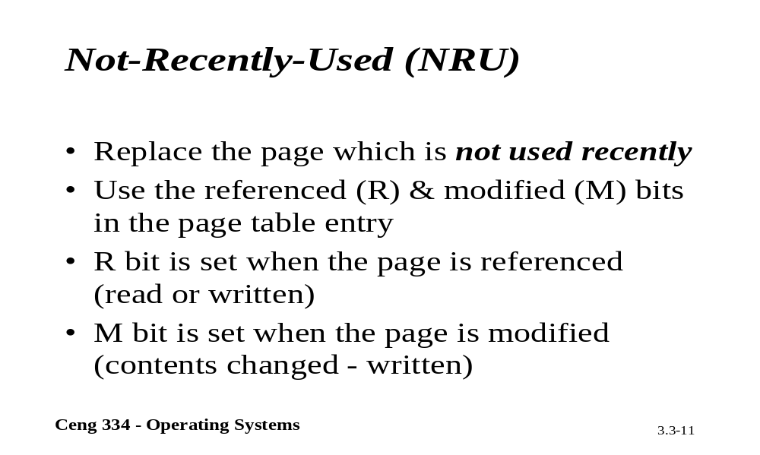
NRU

Slide 15
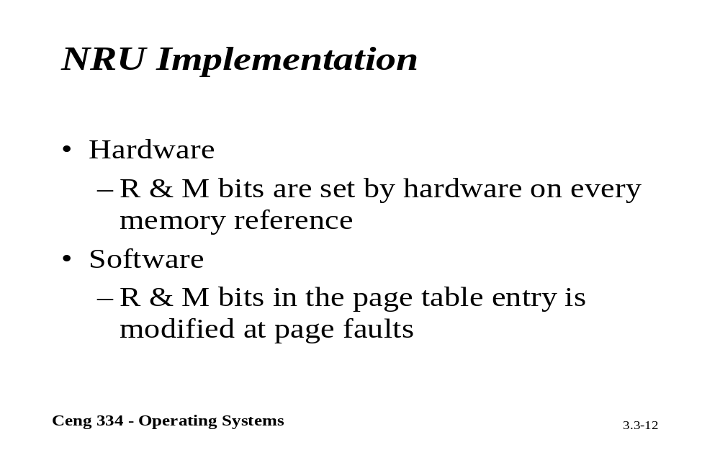
NRU Implementation

Slide 16
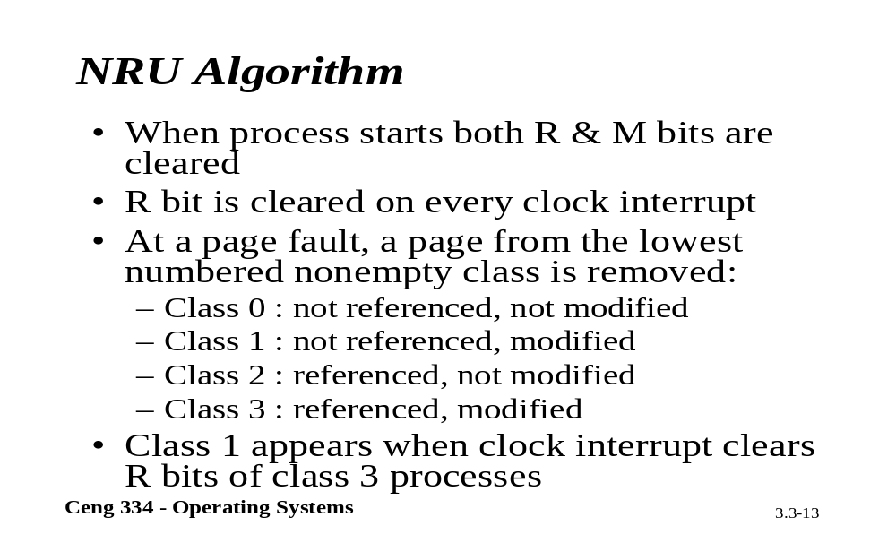
NRU Algorithm

Slide 17
Not Recently Used Page Replacement Algorithm
Each page has Reference bit, Modified bit
  bits are set when page is referenced, modified
Pages are classified
  not referenced, not modified
  not referenced, modified
  referenced, not modified
  referenced, modified
NRU removes page at random
  from lowest numbered non empty class

Slide 18
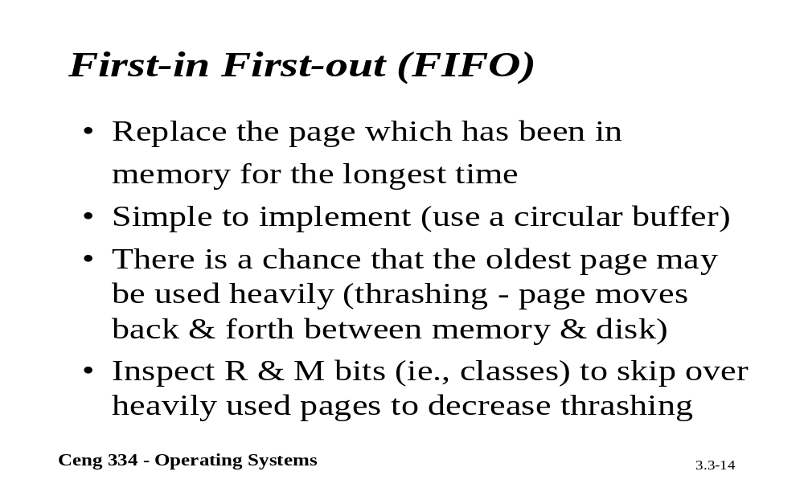
FIFO

Slide 19
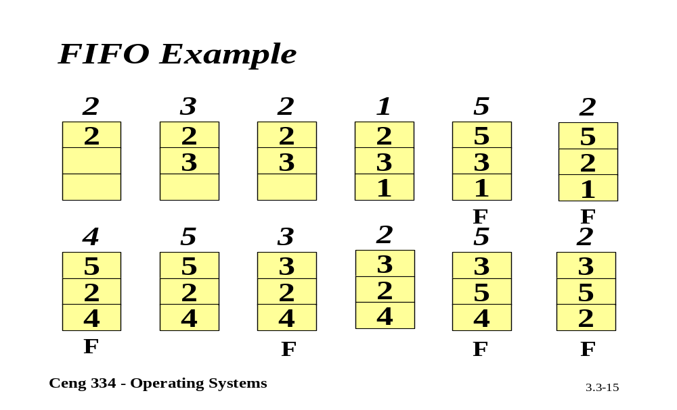
FIFO Example

Slide 20
FIFO Page Replacement Algorithm
Maintain a linked list of all pages
  in order they came into memory
Page at beginning of list replaced
Disadvantage
  page in memory the longest may be often used

Slide 21
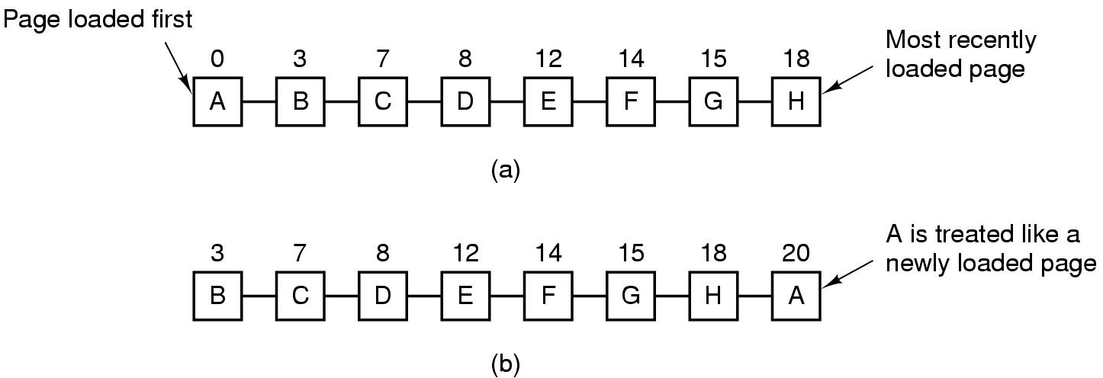
Second Chance Page Replacement Algorithm
Operation of a second chance
  pages sorted in FIFO order
  Page list if fault occurs at time 20, A has R bit set
  (numbers above pages are loading times)

Slide 22
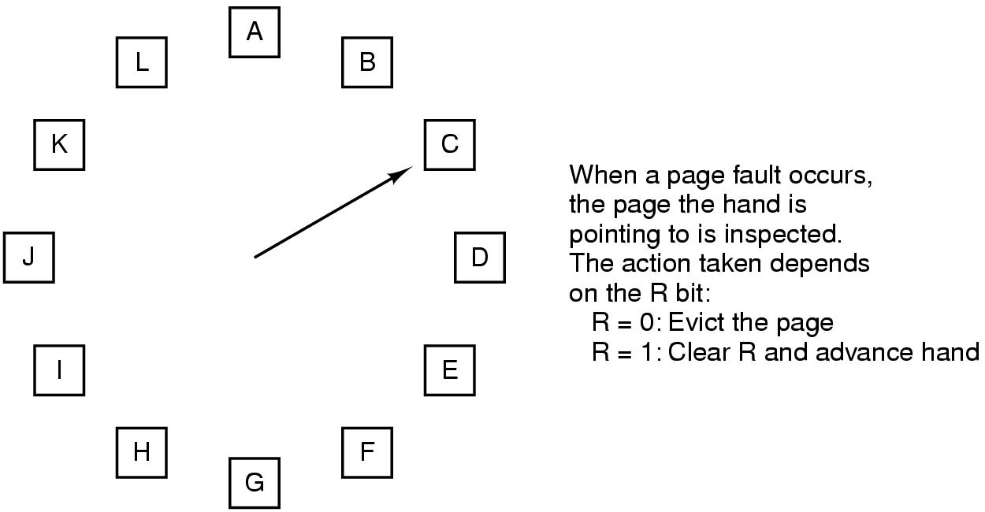
The Clock Page Replacement Algorithm

Slide 23
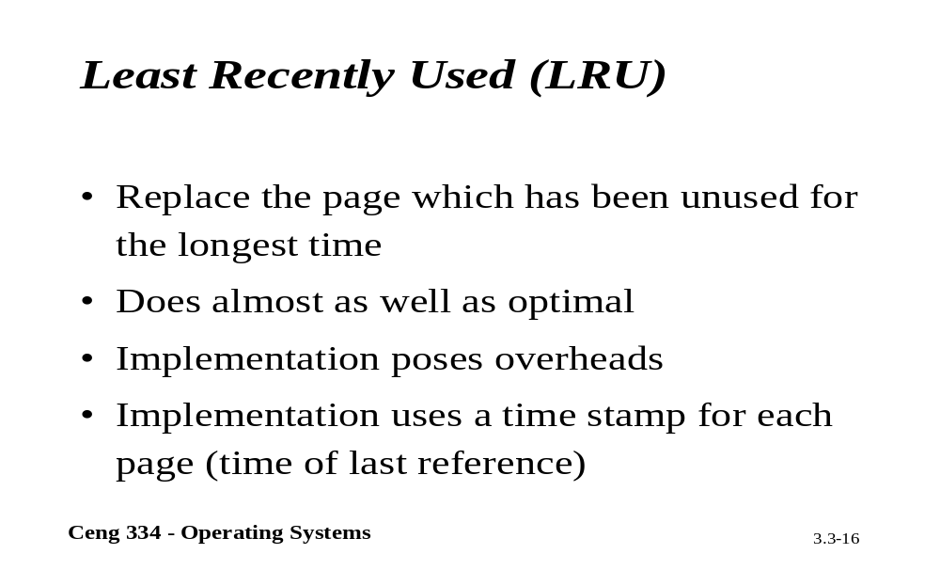
LRU

Slide 24
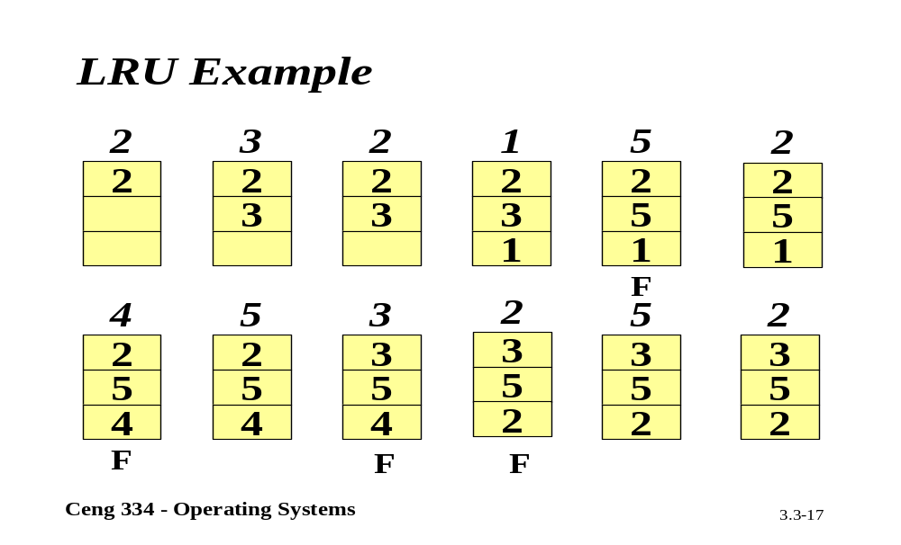
LRU Example

Slide 25
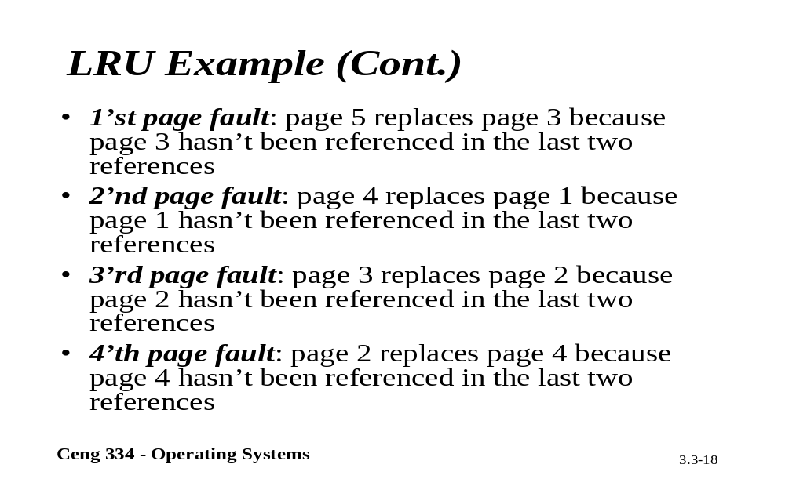
LRU Example

Slide 26
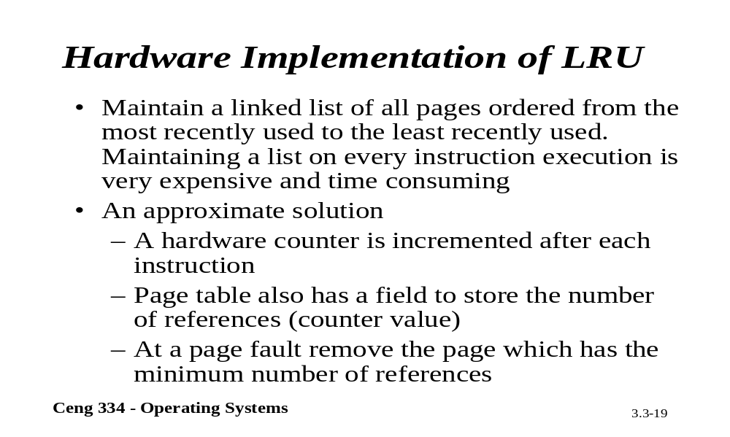
Hardware LRU

Slide 27
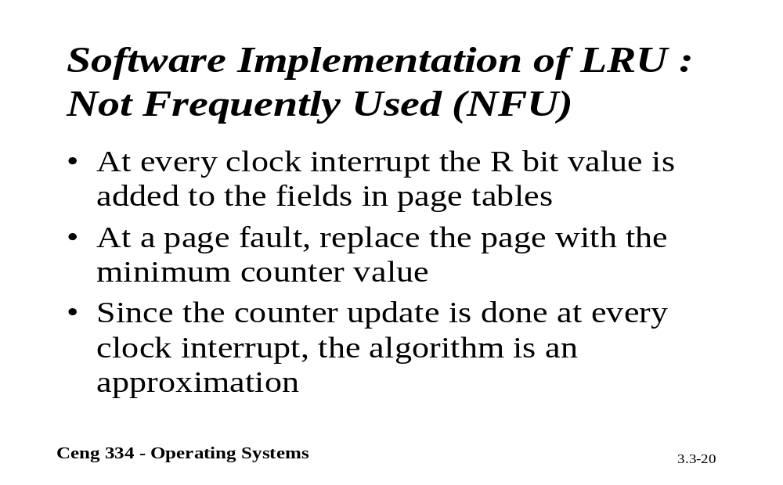
Software LRU: NFU

Slide 28
Least Recently Used (LRU)
Assume pages used recently will used again soon
  throw out page that has been unused for longest time
Must keep a linked list of pages
  most recently used at front, least at rear
  update this list every memory reference !!
Alternatively keep counter in each page table entry
  choose page with lowest value counter
  periodically zero the counter

Slide 29
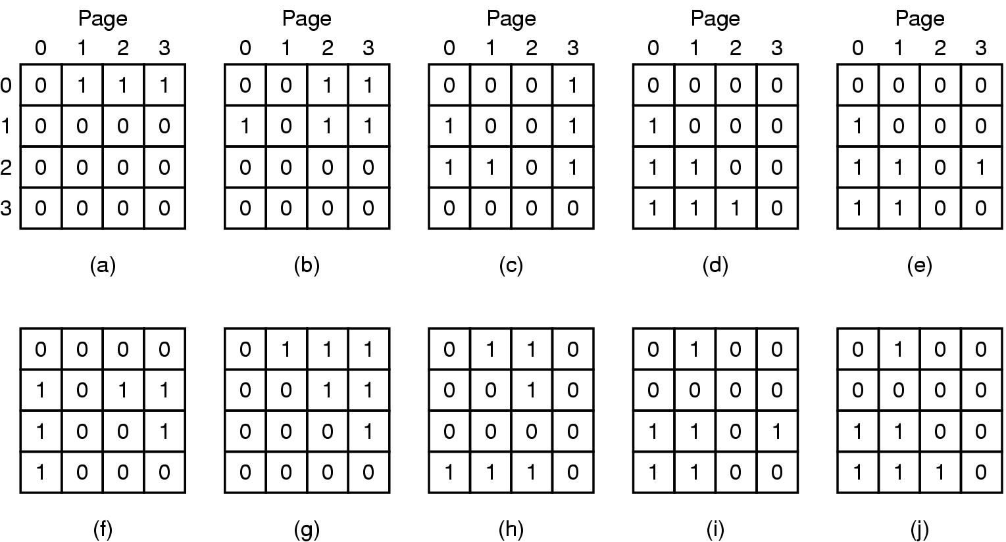
Simulating LRU in Software (1)
LRU using a matrix – pages referenced in order 0,1,2,3,2,1,0,3,2,3

Slide 30
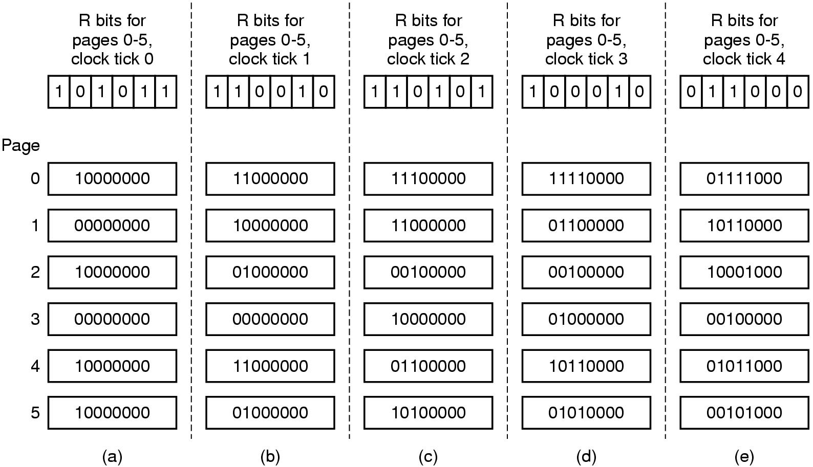
Simulating LRU in Software (2)
The aging algorithm simulates LRU in software
Note 6 pages for 5 clock ticks, (a) – (e)

Slide 31
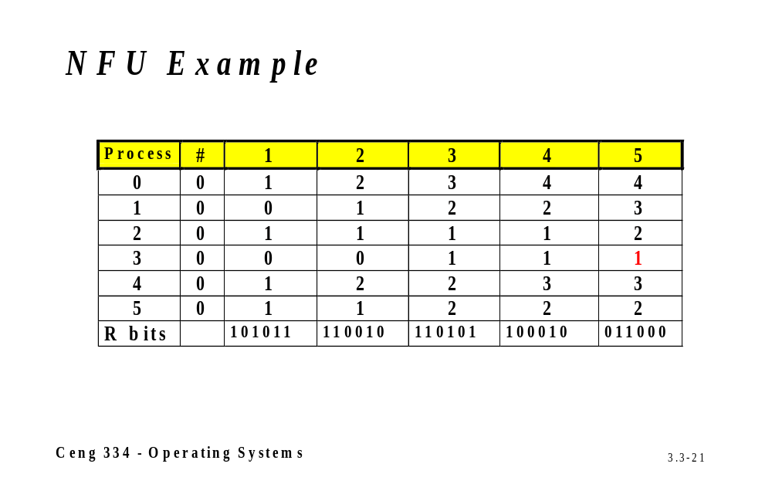
NFU Example

Slide 32
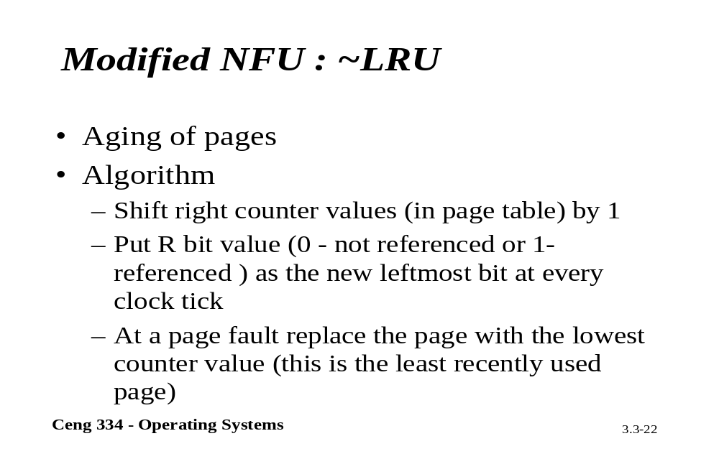
Modified NFU : ~LRU

Slide 33
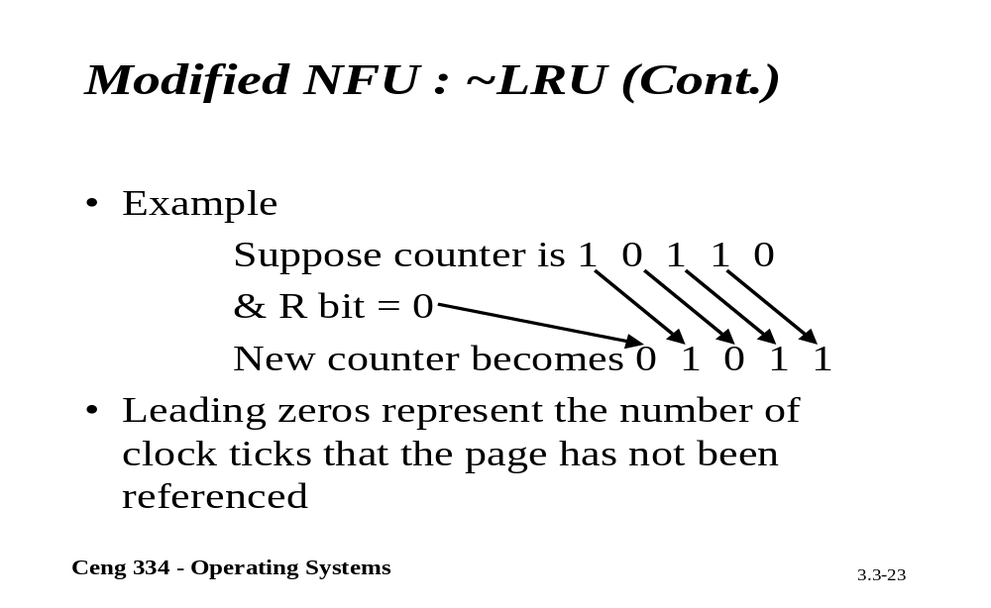
Modified NFU : ~LRU

Slide 34
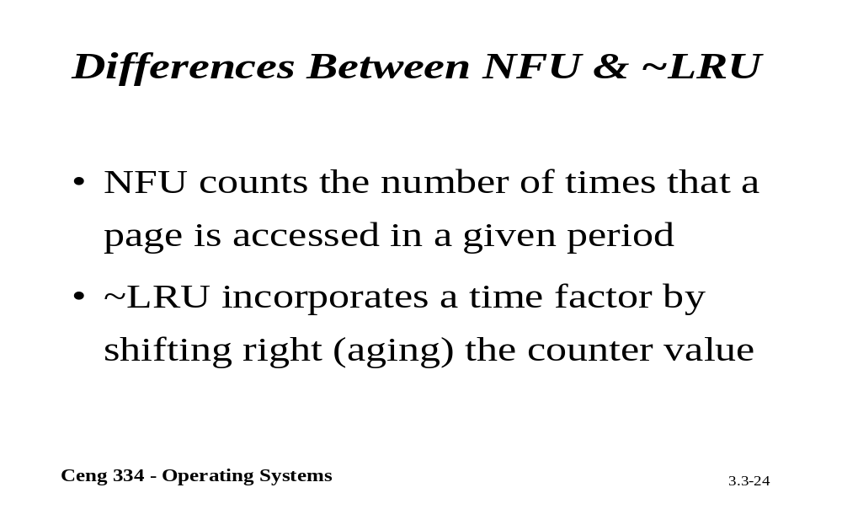
Compare NFU and ~LRU

Slide 35
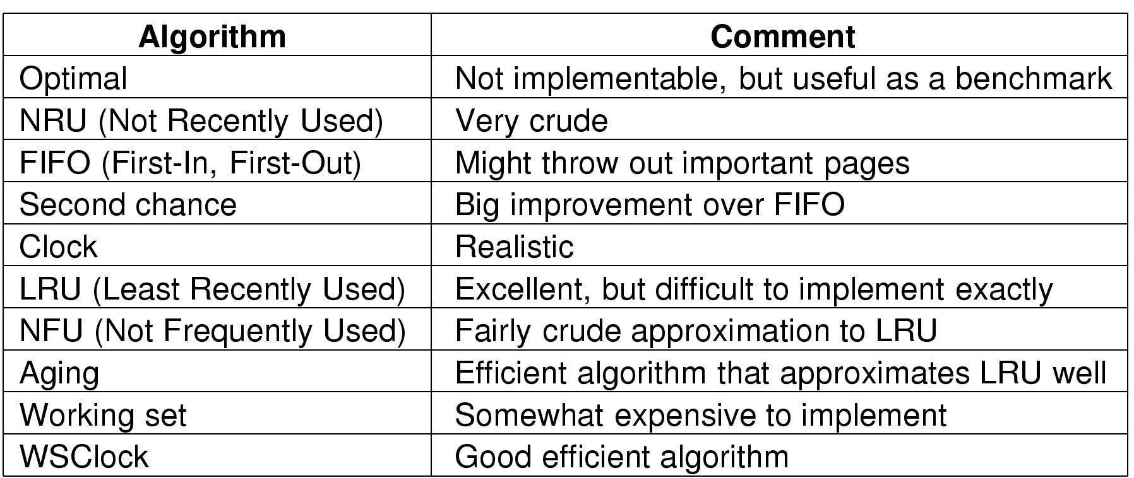
Review of Page Replacement Algorithms

Slide 36
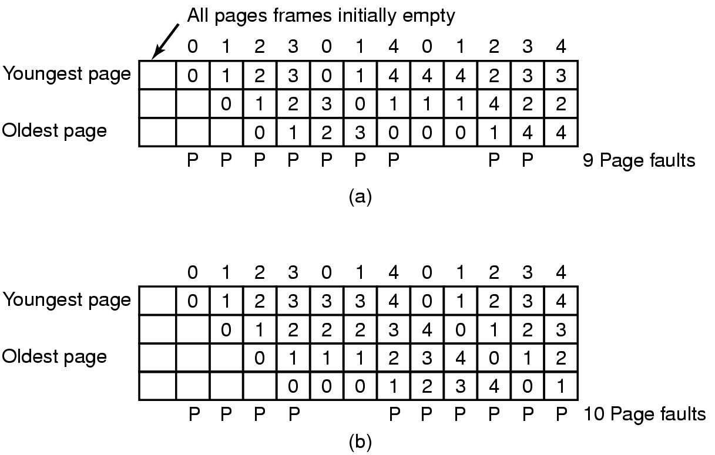
Modeling Page Replacement Algorithms
Belady's Anomaly
FIFO with 3 page frames
FIFO with 4 page frames
P's show which page references show page faults

Slide 37
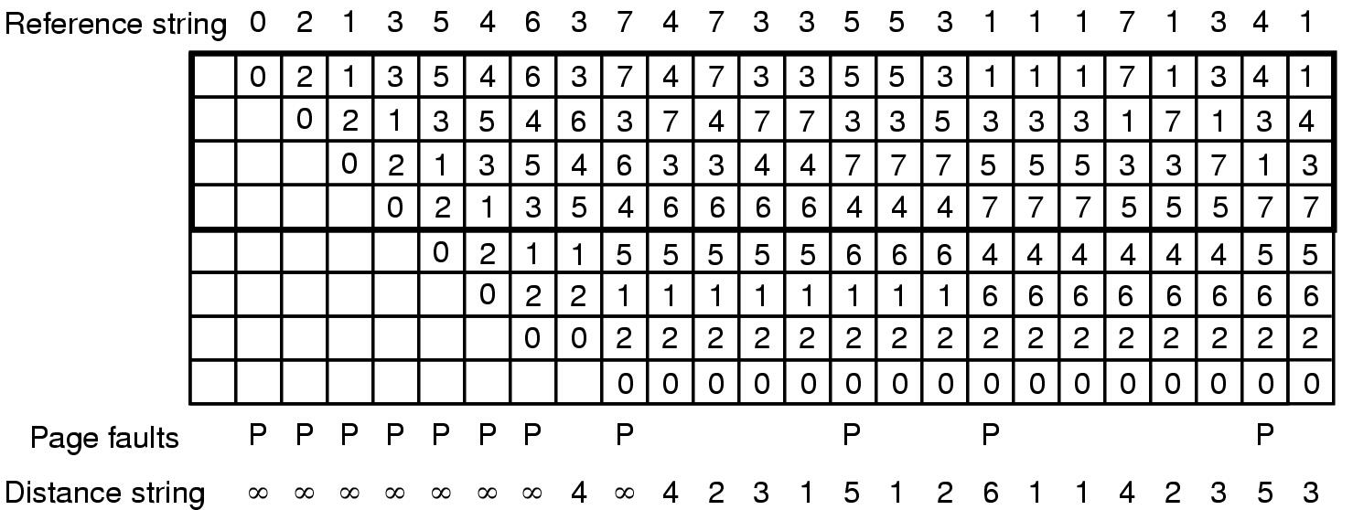
Stack Algorithms
7 4 6 5
State of memory array, M, after each item in reference string is processed

Slide 38
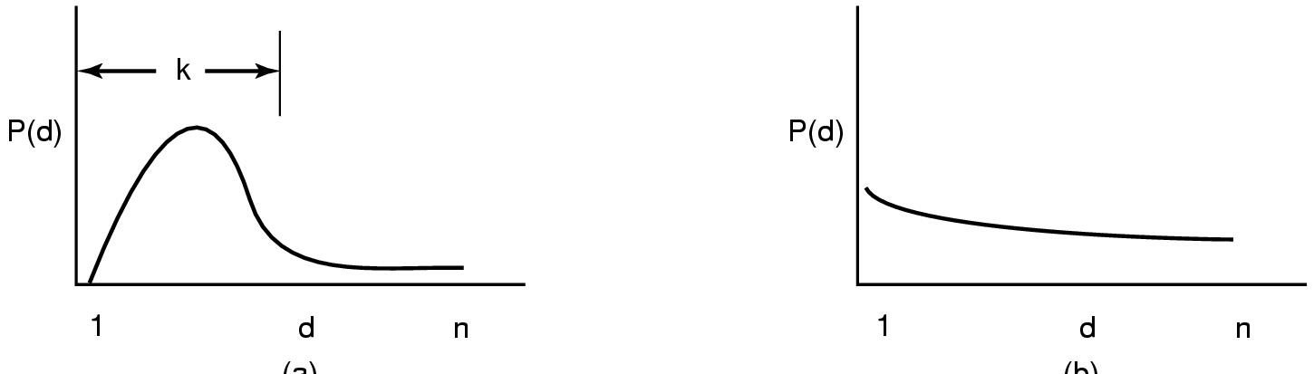
The Distance String
Probability density functions for two hypothetical distance strings

Slide 39
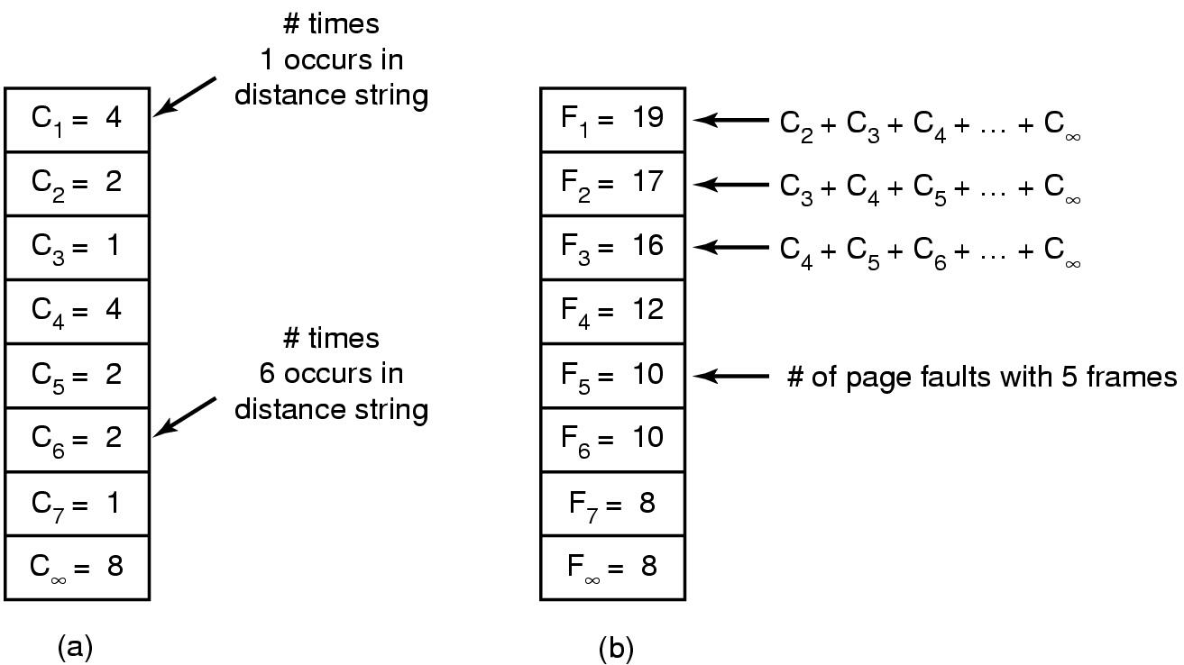
The Distance String
Computation of page fault rate from distance string
  the C vector
  the F vector

Slide 40
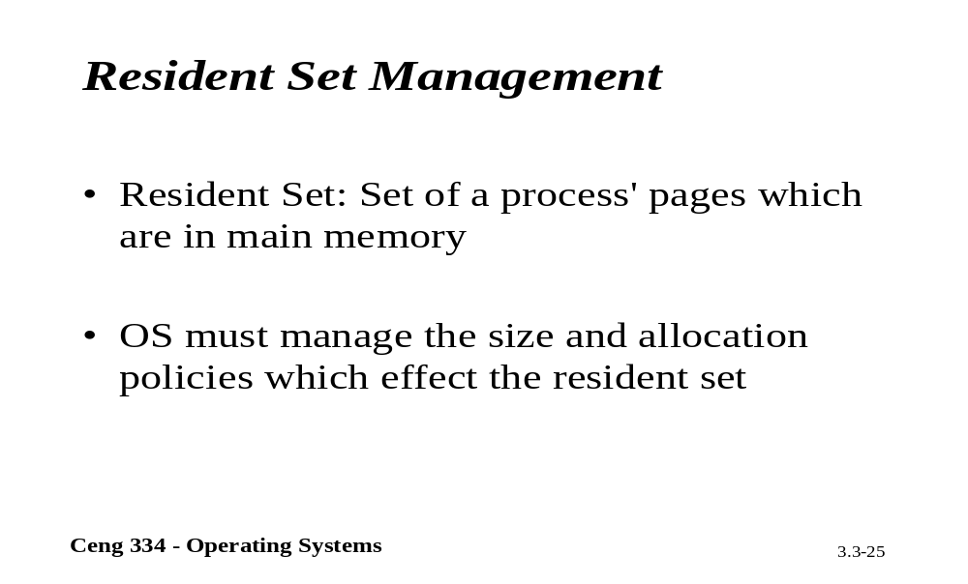
Resident Set Mangement

Slide 41
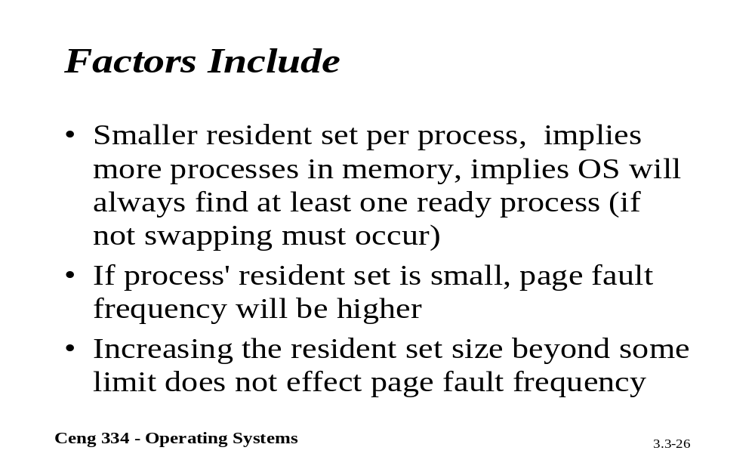
Factor Include

Slide 42
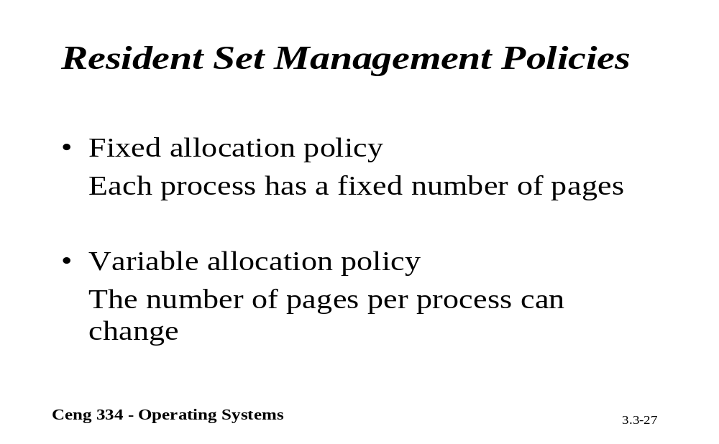
Resident set Manag. Policy.

Slide 43
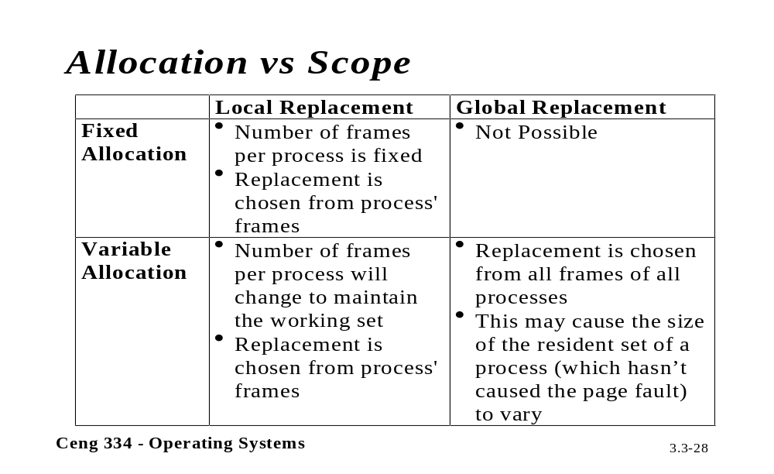
Allocation Vesus Scope

Slide 44
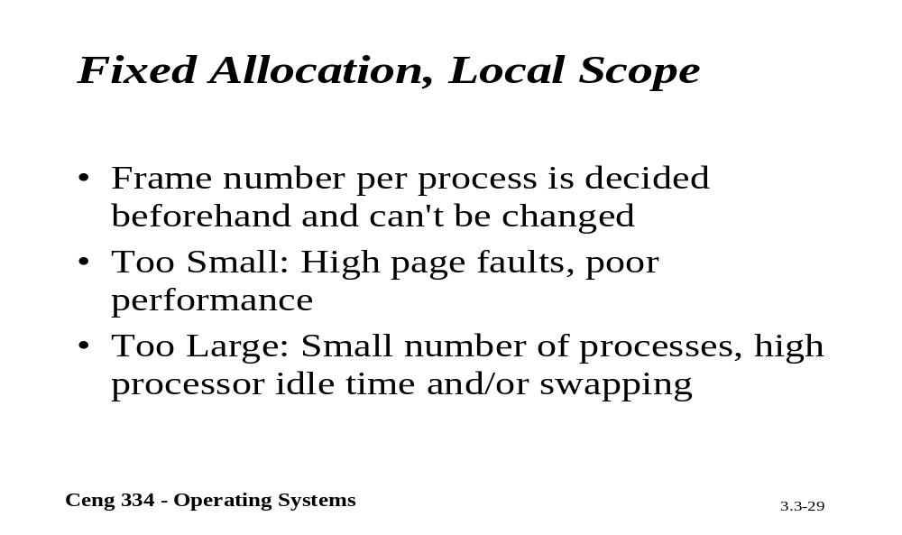
Fixed Allocation, Local Scope

Slide 45
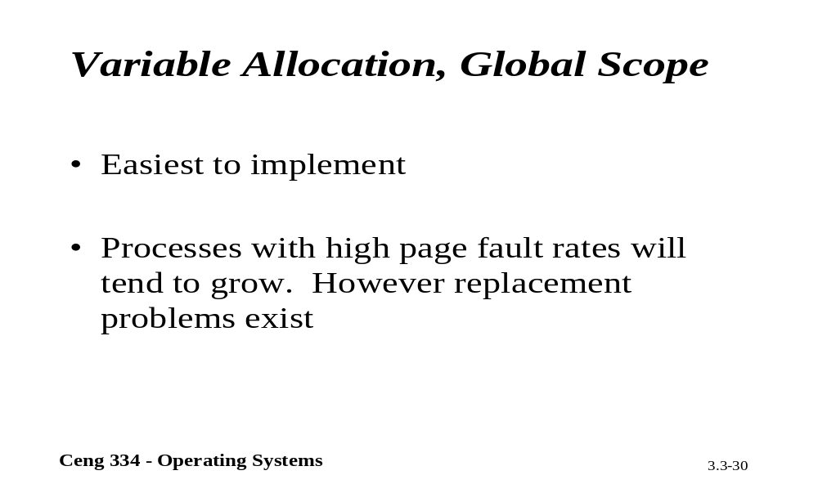
Variable Allocation, Global Scope

Slide 46
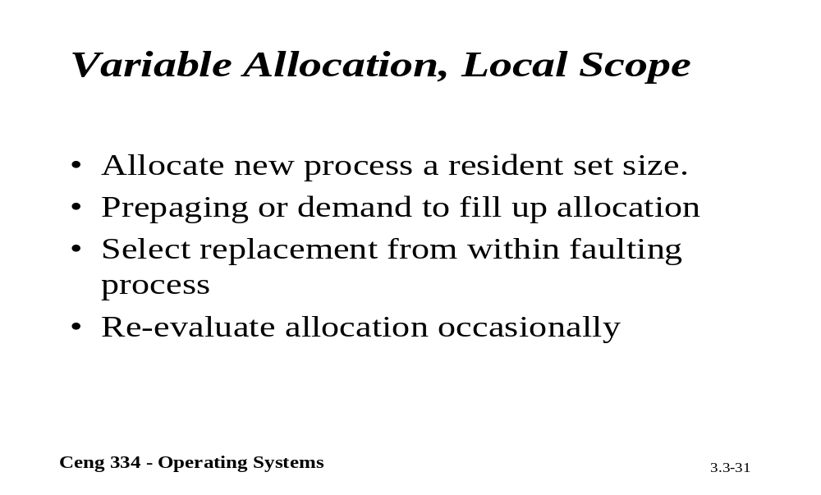
Variable Allocation, Local Scope

Slide 47
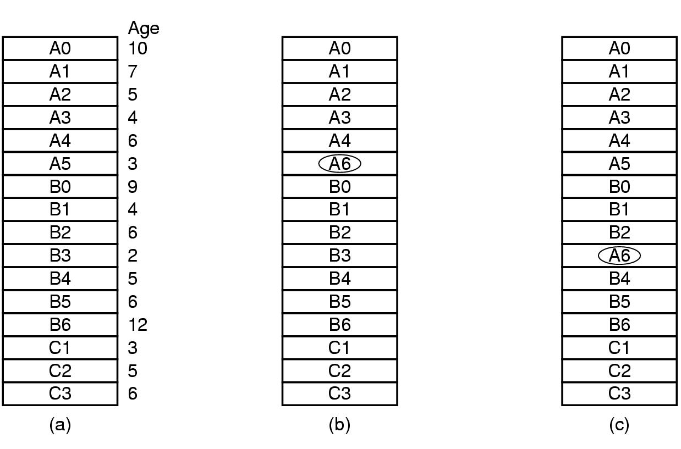
Design Issues for Paging Systems
Local versus Global Allocation Policies (1)
Original configuration
Local page replacement
Global page replacement

Slide 48
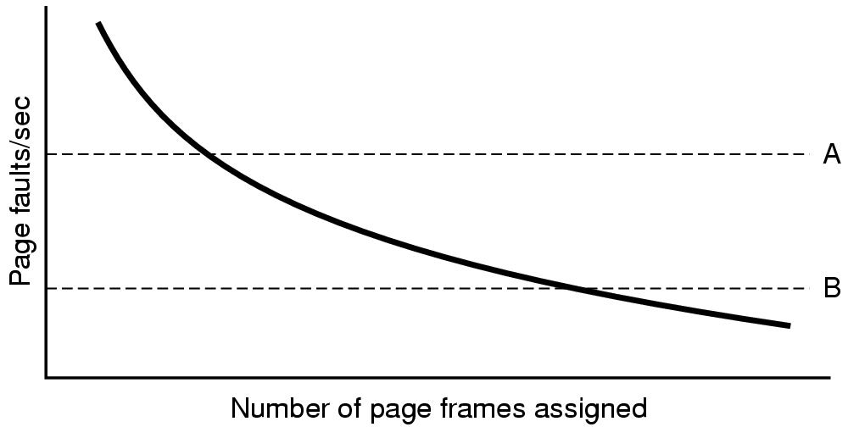
Local versus Global Allocation Policies (2)
Page fault rate as a function of the number of page frames assigned

Slide 49
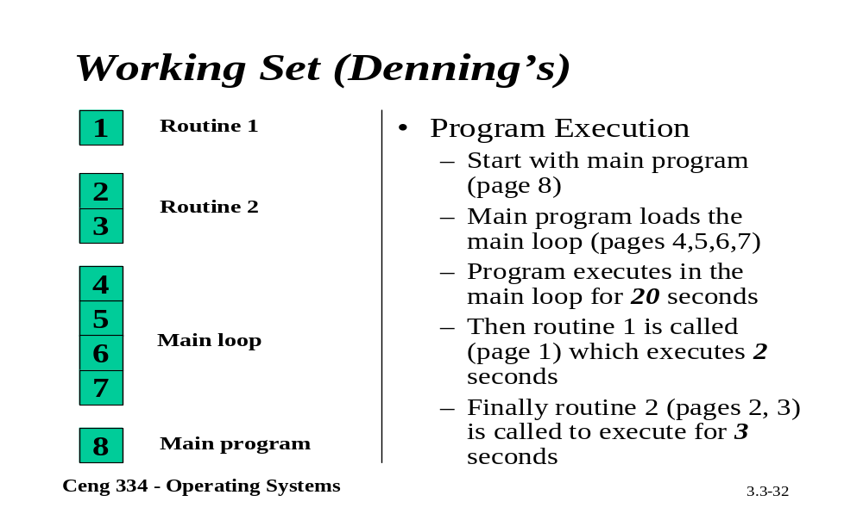
Working Set

Slide 50
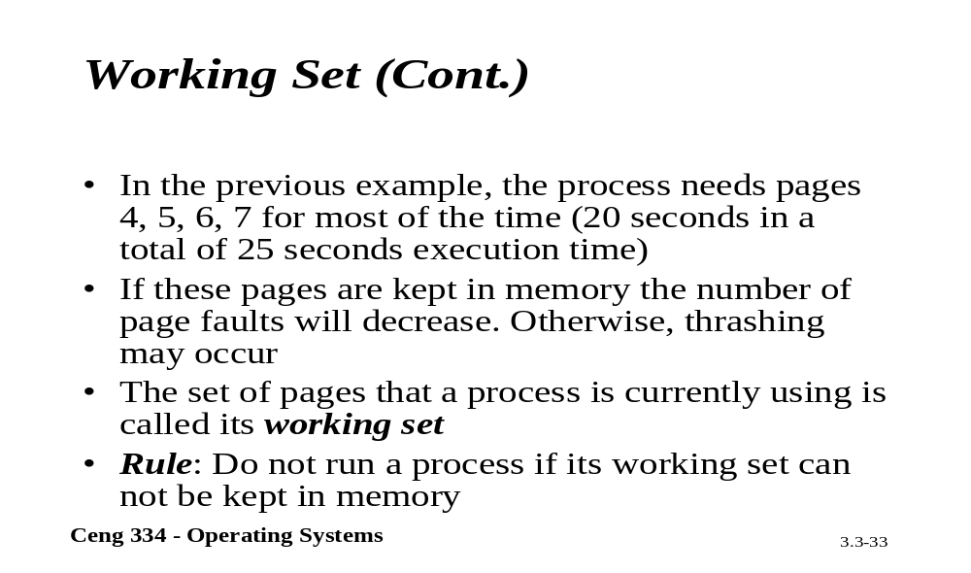
Working Set

Slide 51
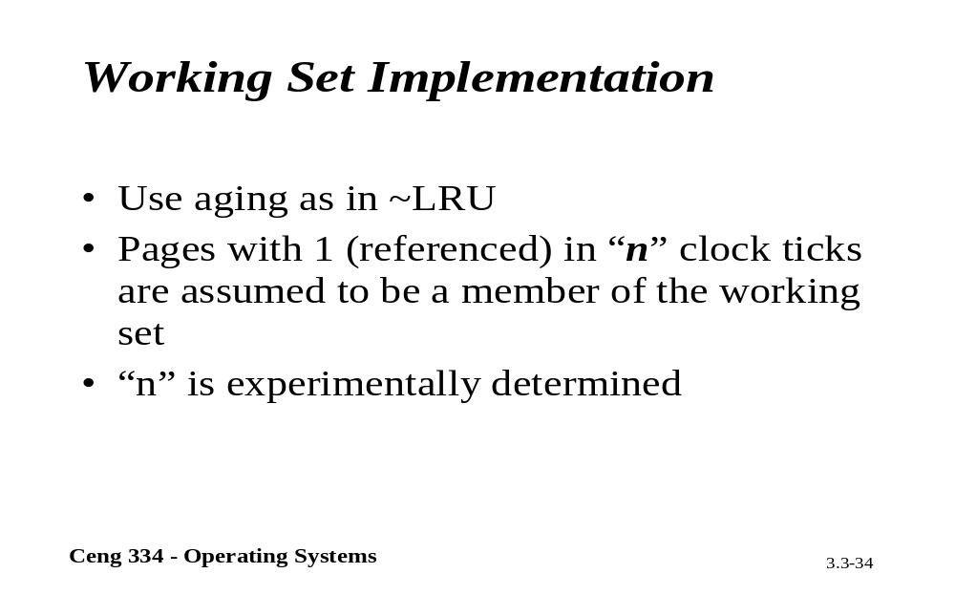
Working Set Implementation

Slide 52
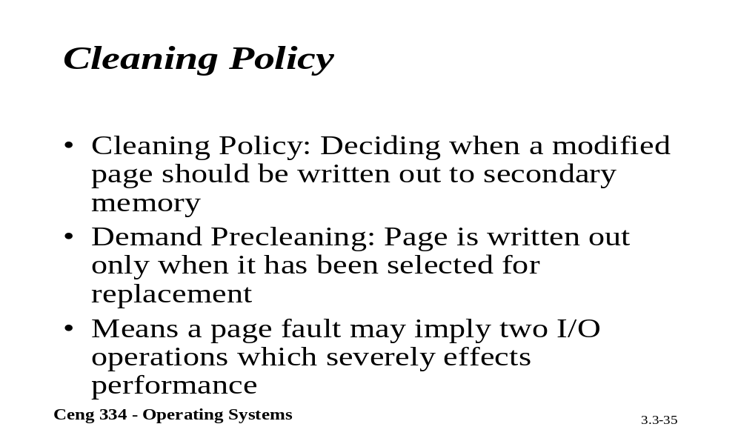
Cleaning Policy

Slide 53
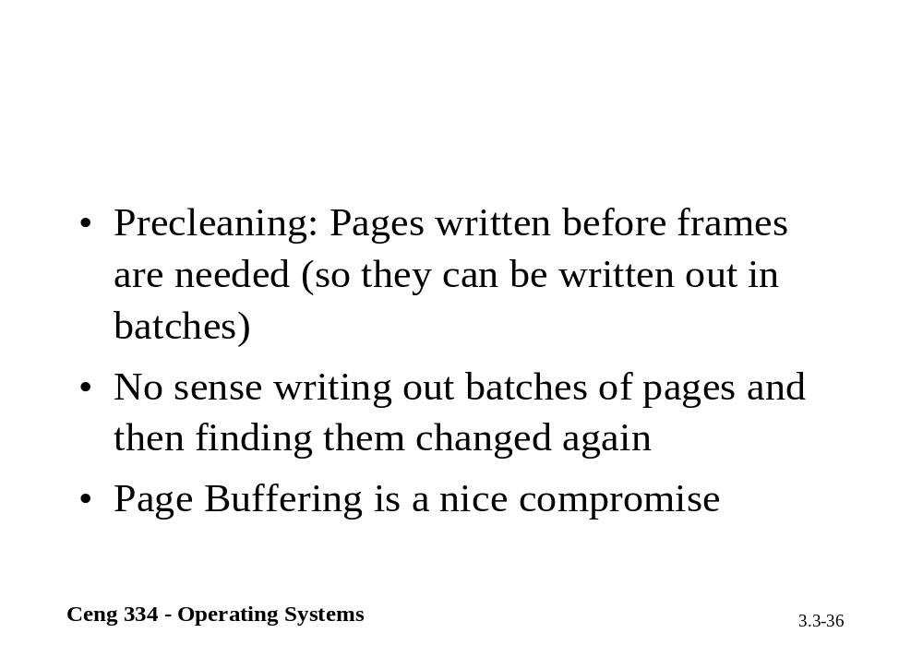

Slide 54
Cleaning Policy
Need for a background process, paging daemon
  periodically inspects state of memory
When too few frames are free
  selects pages to evict using a replacement algorithm
It can use same circular list (clock)
  as regular page replacement algorithmbut with diff ptr

Slide 55
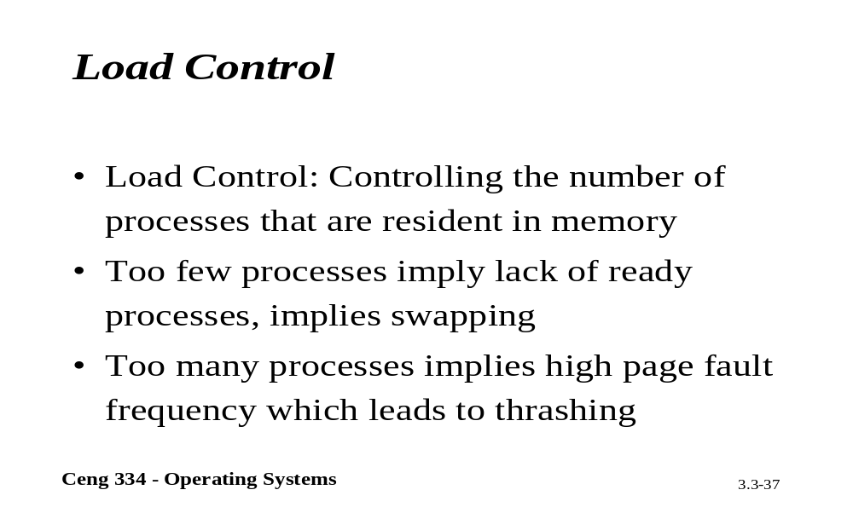
Load Control

Slide 56
Load Control
Despite good designs, system may still thrash
When PFF algorithm indicates
  some processes need more memory
  but no processes need less
Solution :
Reduce number of processes competing for memory
  swap one or more to disk, divide up pages they held
  reconsider degree of multiprogramming

Slide 57
Implementation Issues
Operating System Involvement with Paging
Four times when OS involved with paging
Process creation
  determine program size
  create page table
Process execution
  MMU reset for new process
  TLB flushed
Page fault time
  determine virtual address causing fault
  swap target page out, needed page in
Process termination time
  release page table, pages

Slide 58
Page Fault Handling (1)
Hardware traps to kernel
General registers saved
OS determines which virtual page needed
OS checks validity of address, seeks page frame
If selected frame is dirty, write it to disk

Slide 59
Page Fault Handling (2)
OS brings schedules new page in from disk
Page tables updated
Faulting instruction backed up to when it began
Faulting process scheduled
Registers restored
Program continues

Slide 60
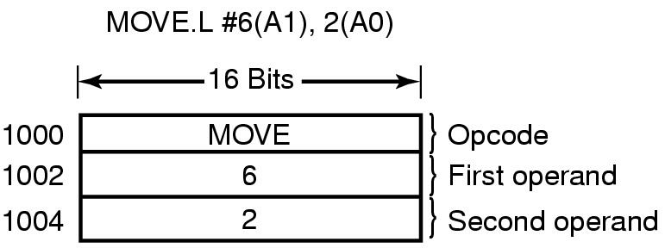
Instruction Backup
An instruction causing a page fault

Slide 61
Page Size (1)
Small page size
Advantages
  less internal fragmentation
  better fit for various data structures, code sections
  less unused program in memory
Disadvantages
  programs need many pages, larger page tables

Slide 62
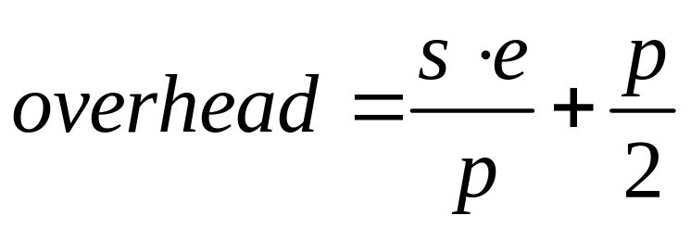

Page Size (2)
Overhead due to page table and internal fragmentation
Where
  s = average process size in bytes
  p = page size in bytes
  e = page entry
page table space
internal fragmentation
Optimized when

Slide 63
Locking Pages in Memory
Virtual memory and I/O occasionally interact
Proc issues call for read from device into buffer
  while waiting for I/O, another processes starts up
  has a page fault
  buffer for the first proc may be chosen to be paged out
Need to specify some pages locked
  exempted from being target pages

